Slide 1
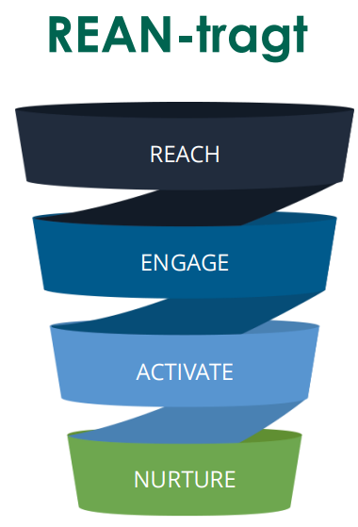
Machine learning Results:
Best subset results :
 | Lasso | Ridge | Best subset
Normalized_RMSE_test | 0.62 | 0.64 | 0.61
Normalized_RMSE_train | 0.62 | 0.634 | 0.61
R_anden | 0.67 | 0.67 | 0.67
variabler antal | 11 | 26 | 9
Variabel | Koefficient
Intercept | -2441562
år | 1606
modstanderhold_stillinglow_superligua | 129.4
modstanderhold_stillingmedium_superligua | 172.7
modstanderhold_stillingtop_superligua | 246.8
win_ratio_3 | 15
rain | -34.6
dag_kategori_feriehverdag.efterårsferie | -49
ferieefterårsferie | -6.26
Strategic Recommendations Based on Data Analysis and Machine Learning Results
1. Reach & Engage:
Increase announcements about team rankings and share VFF’s successes to boost engagement.
2. Nurture & Activate:
During lower team performance, offer exclusive content to maintain fan interest.
Improve facilities such as shelters and VIP lounges, and provide raincoats for guests.
Organize indoor networking events exclusively for VIPs during bad weather to enhance satisfaction and attract new VIP members.
Make matches an attractive leisure activity for families by offering special menus or entertainment, exclusively for VIP guests.

